Slide 1
ELEMENTARY STATISTICS, BLUMAN
Confidence Interval for a Mean Part 2 of 2
© 2019 McGraw-Hill Education. All rights reserved. Authorized only for instructor use in the classroom. No reproduction or further distribution permitted without the prior written consent of McGraw-Hill Education.

Slide 2
Objectives for this PowerPoint
Learn how to construct a confidence interval estimate for the population mean
Learn how to calculate the margin of error for a confidence interval estimate

Slide 3
Problem
The Antarctic Sea Ice Extent was measured for a sample of 37 days also. The mean was 9.9 million square kilometers and the standard deviation was 4.7 million square kilometers.
Calculate a 95% confidence interval estimate for the population mean Antarctic Sea Ice Extent.

Slide 4
Margin of Error
We will calculate the margin of error and add it to and subtract it from the sample mean.
Recall that the calculation of the margin of error requires the use of a value from the t distribution. Our confidence level is to be 95%.
d.f. = 37 - 1 = 36
We will examine the table and look across the top row for our 95% confidence level. This is the column that we will get our t value from. Now we will drop down until we find 36 degrees of freedom and find out where that crosses up with the 95% column and we have a value of 2.028.

Slide 5
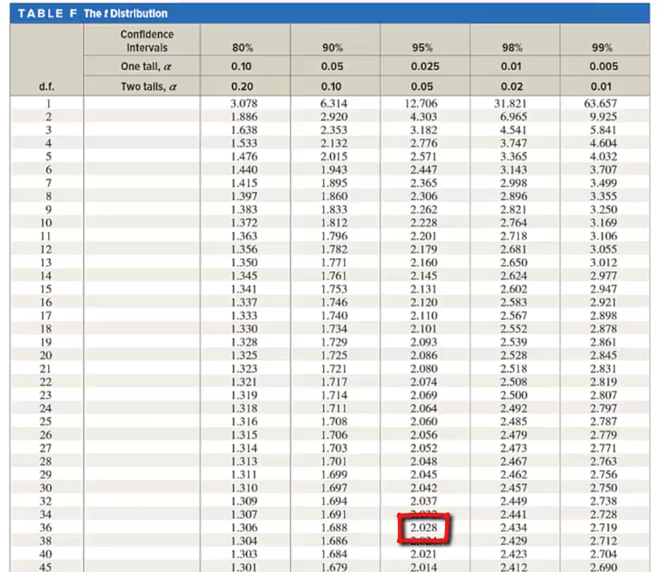
T Distribution

Slide 6

Calculation of Confidence Interval
Calculate the left and right endpoints.
$$E=t_{\frac{α}{2}}\left(\frac{s}{\sqrt{n}}\right)$$
$9.9−2.028\left(\frac{4.7}{\sqrt{37}}\right)=8.3$ $9.9+2.028\left(\frac{4.7}{\sqrt{37}}\right)=11.5$
Our interpretation of this interval will be stated as follows:
It can be stated with 95% confidence that the population mean Antarctic Sea Ice Extent is between 8.3 and 11.5 million square kilometers.

Slide 7
Interval
The interval for the Arctic Ice Sea Extent was a bit narrower than that for the Antarctic Sea Ice Extent. Note that the standard deviation for Antarctica is considerably larger. This caused a margin of error to be greater which resulted in a wider interval.

Slide 8
Summary
In this PowerPoint, we learned how to construct a confidence interval estimate for the population mean and how to calculate the margin of error for a confidence interval estimate.

